Slide 1


Program Monthly Meeting January 08, 2025 Welcome to INCOSE WMA
6:30 pm – 7:00 pm Administrative Updates
7:00 pm – 8:00 pm 2025 BoD Induction and Oath Ceremony; President Ralf Hartmann “INCOSE in 2025”

Slide 2




Welcome and Member Recognition
START RECORDING THE MEETING ​
Welcome to the Monthly INCOSE WMA Program Meeting
Dial In Participants
New Members
1st time at an INCOSE meeting

Slide 3
Virtual Housekeeping
Check-In
If you are dialing in, please send an email to programs@incosewma.org to confirm your attendance
Mute your phone and/or microphone
Networking Opportunity - Exchange Business Information/Opportunities/Interests in the Chat

Slide 4
President’s Message
Happy New Year and Welcome to January 2025!
INCOSE WMA
Out-going Chapter President’s Message (Mr. Thomas)
Incoming Chapter President’s Message (Dr. Studevent)
INCOSE President “INCOSE 2025” (Mr. Ralf Hartmann)

Slide 5
2024 WMA Board & Liaisons
President: Mr. Gary Thomas
VP/President-Elect: Dr. Lowanda Studevent
Past-President: Dr. Houng Soo, CSEP
Programs Chair: Ms. Ruchira Puri
Treasurer: Mr. Brian Massa
Secretary: Ms. Barbara Staples
Director-at-Large: Ms. Roneal Josephs, ASEP
Director-at-Large: Mr. William Scheible, ESEP
Communications Chair: Mr. Michael O’Connor
Tutorial Chair: Mr. Kyle Miller, ASEP
Membership Chair: Ms. Lisa Winchester
Ambassador Chair: Michael Jordan
Event Coordinator: Ms. Kathleen Flynn, CSEP
Newsletter Editor: Nalini Muppala
Student Chapter Faculty Advisor:
GMU - Professor Matthew Amissah
VA Tech - Professor Taylan Topcu
GWU – Professor Eric Dano

Slide 6
GMU INCOSE Student Division
GMU Student Division Officers
President - Emaan Abbasi - eabbasi2@gmu.edu
Vice President - Zaara Fuad - zfuad@gmu.edu
Secretary - Salma Awad - sawad3@gmu.edu
Treasurer - Hasan Alwahab - halwaha@gmu.edu
Faculty Advisor
Professor Matthew Amissah - mamissah@gmu.edu

Slide 7
VA Tech INCOSE Student Division
VA Tech Student Division Officers
President: Shefa Jannatul – shefa@vt.edu
Vice President: Md Doulotuzzaman Xames
Treasurer: Kimiya MohammadiJozani
Event Manager: Trevor Lerardi
Faculty Advisor
Professor Taylan Topcu – ttopcu@vt.edu

Slide 8
GWU INCOSE Student Division
GWU Student Division Officers:
President: Ben Buechner - buechner@gwmail.gwu.edu
Vice President: Amna Maqsood - amnamaq5@gwmail.gwu.edu
Treasurer: Vijay Jayamani
Secretary: Parker Reese
Advertising Coordinator - Newsletter: Alana Lee
Advertising Coordinator - Socials: Lola Nurullaeva
Faculty Advisor:
Professor Eric Dano - ericdano@gwu.edu

Slide 9
Additional Volunteer Opportunities
Ambassador Program Committee
Communications Committee
Chapter Website
Social Media (LinkedIn, Facebook, X)
Publicity/Marketing
Technology and Equipment
Editor Chapter Newsletter
Content Contributors
Election and Nomination Committee
Events Planning Committee
Membership Committee
Programs Committee
Tutorials Committee

Slide 10
2025 BoD Induction and Oath Taking Ceremony

Slide 11
2025 BOD Induction and Oath Taking
President
Vice President/President-Elect
Past President
Treasurer
Secretary
Communications Chair
Program Chair
Director-at-Large
Director-at-Large
Tutorial Chair
Membership Chair
Event Coordinator
Newsletter Editor
Dr. Lowanda Studevent
Dr. Shawn Na, CSEP
Mr. Gary Thomas
Mr. Brian Massa
Ms. Barbara Staples
Mr. Paul DeMarco
Ms. Ruchira Puri
Mr. William Scheible, ESEP
Dr. Houng Soo, CSEP
Mr. Kyle Miller, ASEP
Ms. Lisa Winchester
Ms. Kathleen Flynn, CSEP
Mr. Nalini Muppala

Slide 12
2024 BOD Induction and Oath Taking
As the newly-elected Board of Directors of the Washington Metropolitan Area chapter of INCOSE, you are responsible for managing the affairs of this organization and providing for the day-to-day operations and management of the chapter.
Do you pledge yourselves to faithfully discharge these responsibilities, in accordance with our Chapter Constitution and By Laws, as board members of the Washington Metropolitan Areas Chapter of INCOSE?
If so, then answer, "I will"
Do you pledge yourselves to fulfill the responsibilities and obligations of your elected office of Washington Metropolitan Areas Chapter of INCOSE, to promote the interests of the chapter so as to assist its development and health, and to serve as a member of the council's board of directors?
If so, then answer, "I will"
Board members, I hereby install each of you into the office to which you have been elected.

Slide 13
2025 WMA Board & Liaisons
President: Dr. Lowanda Studevent
VP/President-Elect: Dr. Shawn Na, CSEP
Past-President: Mr. Gary Thomas
Programs Chair: Ms. Ruchira Puri
Treasurer: Mr. Brian Massa
Secretary: Ms. Barbara Staples
Director-at-Large: Mr. William Scheible, ESEP
Director-at-Large: Dr. Houng Soo, CSEP
Communications Chair: Mr. Paul DeMarco
Tutorial Chair: Mr. Kyle Miller, ASEP
Membership Chair: Ms. Lisa Winchester
Ambassador Chair: Vacant
Event Coordinator: Ms. Kathleen Flynn, CSEP
Newsletter Editor: Nalini Muppala
Student Division Faculty Advisor:
GMU -- Professor Matthew Amissah
VA Tech -- Professor Taylan Topcu
GWU – Professor Eric Dano

Slide 14

2024 New SEP Recognitions
60 WMA Chapter members earned SEP certifications in 2024.
ASEP 44
CSEP 14
ESP 2
------------
Total 60
INCOSE WMA 2025 PROGRAM Meeting

Slide 15

44 New ASEPs
Amir H. Abrari
Jonathan Bennett
Josiah Thomas Boman
Kimberly Capers
Brandon Cody Collins
Alexander Day
Emma Catherine Devine
Steven Michael Drost
Julie Frappier
Cullen Michael Hanks
Kwaku Impraim
Darius Jack
Max Quinn Kirby
Venkatesh Krishnamoorthy
James Krumm
Robert Thompson Kuntz
Megan Liranzo
Mikeal Lockard
Stephen Loman
Benjamin Mangel
William Markowitz
Adam Ilesh Menon
Brandon Miller
Tracy Nguyen
Spain Arthur Niemer
Chand Patel
Austin Pursley
Christopher James Quatroche
Jeffrey Grean Delos Angeles Ramos
Semmie Rush
Alexis Daniel Grassette Santos
Connor Scala
Erin Schick
Thomas Schilling
Ryan David Stuckey
Gurkirt Tahim
Cullen Tores
Christopher Mark VanYe
Carolyn Vaseghi
Aaron Bergantinos Villaverde
Neil Whalen
Shemar Wilkins
Tesfamichael Worku
John Young

Slide 16

14 New CSEPs
Relmane Baptiste
Eric Anthony Bash
Kathryn Elizabeth Carr
Kathleen Helen Flynn
Scott Tyler Frampton
Nila Fridley
Christian David Hermann
Dave Ingalls
Sean Ivey
Shaun Jenkins
Miracle Ihemrochi Onyebuchim
Carlo Francisco Palma
Scott Richard Peters
Christopher Trumble

Slide 17

2 New ESEPs
Lawrence George Leventhal
Tim Withum

Slide 18
Certification Statistics
INCOSE WMA
INCOSE International
Level | Number
ASEP | 124
CSEP | 248
ESEP | 49
Total | 421
Level | Number
ASEP | 1776
CSEP | 2490
ESEP | 382
Total | 4648
As of 2 January 2025
As of 18 January 2024

Slide 19
INCOSE WMA Demographics
As of 2 January 2025
Location | Number
DC | 38
MD | 177
VA | 553
Other* | 68
Total | 836
*Other:
26 States
4 Not in US

Slide 20
INCOSE WMA Demographics
As of 2 January 2025
CAB** | Defense Companies | FFRDC*** | Federal Government | DoD | Universities
52 | 24 | 5 | 6 | 19 | 19
**CAB – Corporate Advisory Board
***FFRDC – Federally Funded Research and Development Center

Slide 21
Chapter Newsletter: Schedule
Task | Duration(days) | Iss1 | Iss2 | Iss3 | Iss4 | Description
Input from contributors |  | 3/1/2025 | 5/31/2025 | 8/30/2025 | 11/29/2025 | Material due from contributors
Initial Draft | 3 | 3/4/2025 | 6/3/2025 | 9/2/2025 | 12/2/2025 | Compile material into a newsletter draft
Initial review by BOD | 3 | 3/7/2025 | 6/6/2025 | 9/5/2025 | 12/5/2025 | Review and provide feedback. Still open for content modifications.
Revise | 3 | 3/10/2025 | 6/9/2025 | 9/8/2025 | 12/8/2025 | Update newsletter draft based on feedback
Final review by BOD | 3 | 3/13/2025 | 6/12/2025 | 9/11/2025 | 12/11/2025 | Review and provide final feedback. Closed for major content changes
Finalize & Prepare to publish | 2 | 3/15/2025 | 6/14/2025 | 9/13/2025 | 12/13/2025 | Layout updates and final copy ready for publisher
Publish | 1 | 3/16/2025 | 6/15/2025 | 9/14/2025 | 12/14/2025 | Publish date. This is decided up front to set a regular cadence for newsletter. eg: last Monday of months 3,6,9,12
Archive materials | 2 | 3/18/2025 | 6/17/2025 | 9/16/2025 | 12/16/2025
Please send articles for inclusion in next Chapter Newsletter.
Send contributions to nalini.muppala@incose.net or newsletter@incosewma.org

Slide 22
2025 Program Meetings
Guest Speaker | Date | Time | Location | Topic
BOD INDUCTION and Ralf Hartmann, President of INCOSE | 01/08/25 | 6:30 -8:00 pm | Virtual/ ZOOM | BOD INDUCTION Presentation: Plans for INCOSE in 2025
WMA IW25 Attendees | 02/12/25 | 6:30 -8:00 pm |  | IW25 Debrief from Spain. Gary Thomas, Shawn Na, etc.
Professor Matthew Burkett | 03/12/25 | 6:30 -8:00 pm |  | UVA Briefing

Slide 23

Tutorials Plan 2025
Date | Topic | Presenter(s)
Early 2025 | Intersection of Systems Thinking and Program Management | TBD
TBD 2025 | Guidelines for Digital Engineering Success: From Cultural Adoption to MBSE Basics | TBD
TBD 2025 | Applying Digital Engineering for the Early Integration of Verification Activities with Requirements Engineering | TBD
Tutorial topics are selected per member survey results and tailored by group inputs. Selection of exact dates + locations underway.
Actively seeking presenters. Please contact programs@incosewma.org
if you are interested in presenting a topic in systems engineering! Thank you.

Slide 24

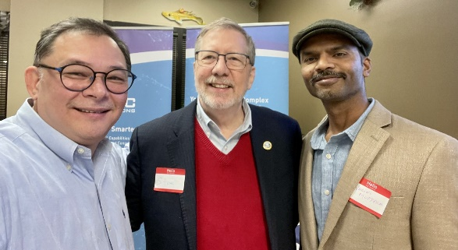
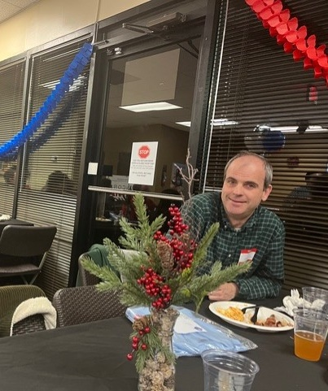
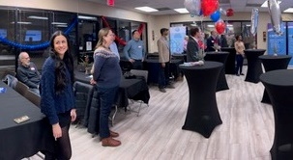
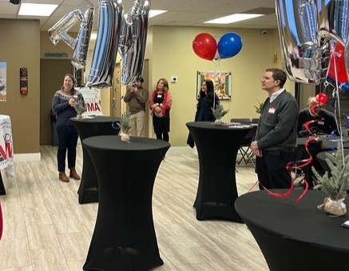
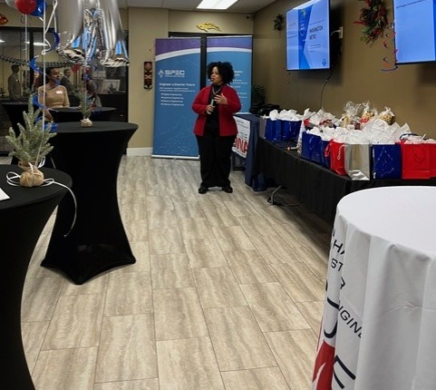
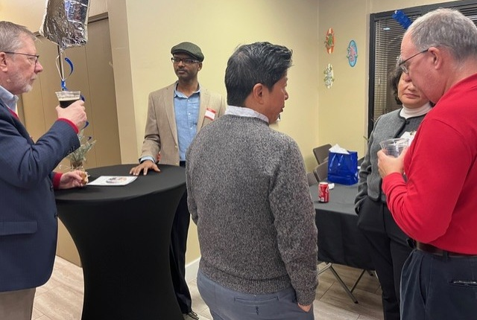
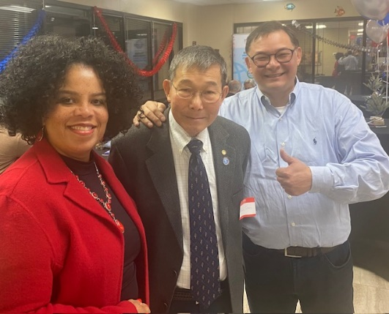
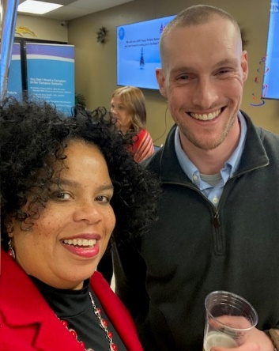
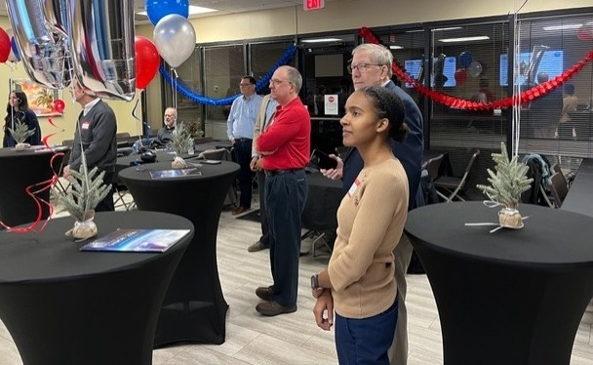
2024 Holiday Party
Year-end celebration on 11 December 2024
highlighted chapter successes!

Slide 25



Quarter 1 (Q1) 2025 Membership Event
The focus of the Q1 2025 membership event will be on natural systems. More information to follow.
A membership meet-and-greet happy hour will be scheduled during Q1 – details to be determined.
Interested in helping to plan an INCOSE WMA event this year? Please contact the INCOSE WMA Event Coordinator, Kathleen Flynn, at events@incosewma.org

Slide 26
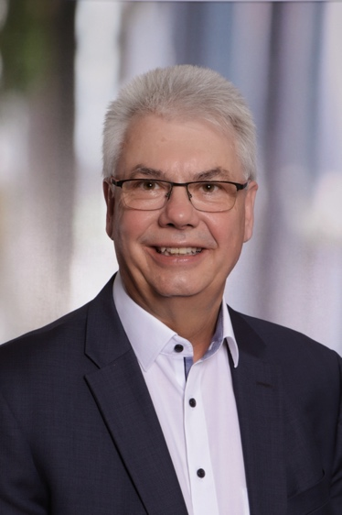
INCOSE in 2025
Ralf Hartmann is currently serving as President of the International Council on Systems Engineering (INCOSE) in 2024 and 2025. Ralf is an active and engaged INCOSE member since 1996 and a founding member of GfSE, the German Chapter of INCOSE. He has been selected as an INCOSE Fellow in 2005 and received the prestigious INCOSE Founders Award in 2008. From 2008 until 2014 Ralf served as INCOSE Director for Strategy and ensured sponsorship of the former SE Vision 2025 in this period.
Ralf received a Diploma in Electrical Engineering from the University of Karlsruhe (KIT) and he is a certified project management professional (GPM/IPMA).
Ralf Hartmann retired from Airbus the end of 2021 after a career of nearly 35 years in space and defense systems covering robotics, automatic control, simulation, S/W development and primarily Systems Engineering. In this period, he held various positions as project manager and vice president of international teams for engineering, research and technology.
Ralf joined the Digital Transformation Office at Airbus Defense & Space in 2017 where he created and led the organization for “Digital Design, Manufacturing and Service” (DDMS). Furthermore, he was Head of Airbus Group Systems Engineering Governance. Along his whole career Ralf Hartmann was an engaged evangelist and promoter of Systems Engineering, the digital transformation and especially its combination.
Today Ralf is a self-employed management and systems engineering consultant.
Ralf Hartmann
President
INCOSE

Slide 27

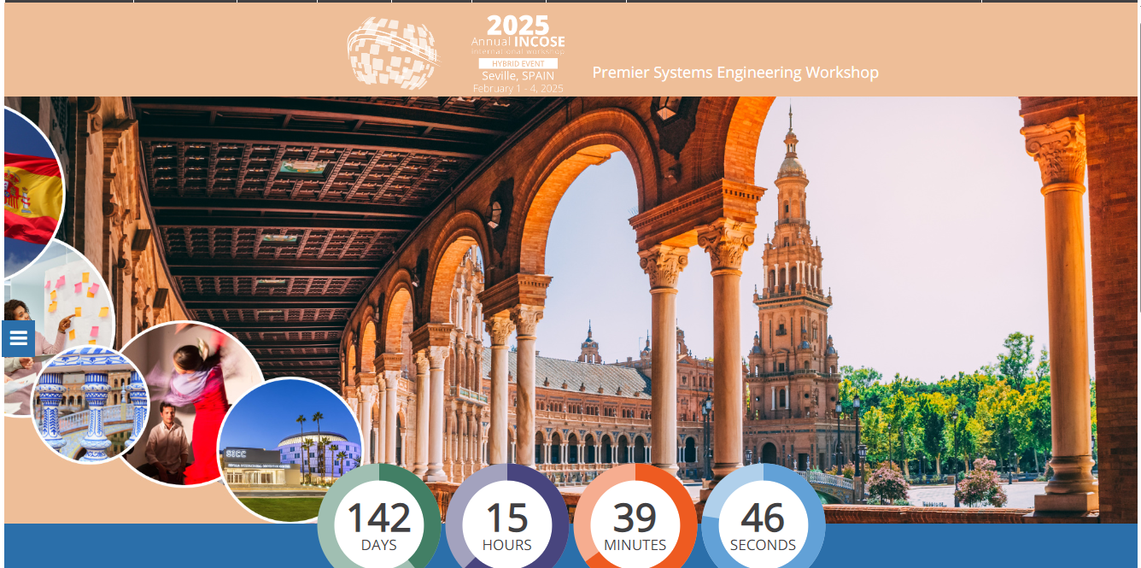

Slide 28
Way Ahead
Complete training for new INCOSE WMA chapter officers (Dr. Soo)
Collaborate and complete Strategic Plan for 2025 (BoD)
Document and Discuss Lessons Learned from 2024 (BoD)
Continue to engage with INCOSE WMA Student Chapters
Work with UVA to form a student chapter (Gary T.)
Engage and establish INCOSE WMA Student Chapters with Howard University, Morgan State University, University of MD (Dr. Studevent)
Establish an INCOSE WMA working group for the 2025 GMUs Andrew P. Sage Systems Engineering Research Competition (Leader-TBD)
Next Monthly Meeting: Wed, Feb 12, 2025

